Slide 1

Load Forecasting for N.Y.C. region

Slide 2
Problem Statement: Forecasting the Demand of Energy using historic data
Brief:
Historic Load Data (Pg. 3)
Historic Weather Data (Pg. 4)
This presentation dwells into the use of historic data to predict the future load demands for the coming year of 2021 and onwards.
After demographic research, As Population is the key to driving the demand of energy in a city, The Empire State’s July 1, 2020, population of 19,336,776 was down 126,355, or 0.65 percent(estimates).
Also, the graphs show a nominal decline in the energy demand which can impact energy suppliers in revenue, and this can be a good opportunity to marginally increase the prices to cut losses.
The visualizations ahead give us a better understanding of the data.

Slide 3
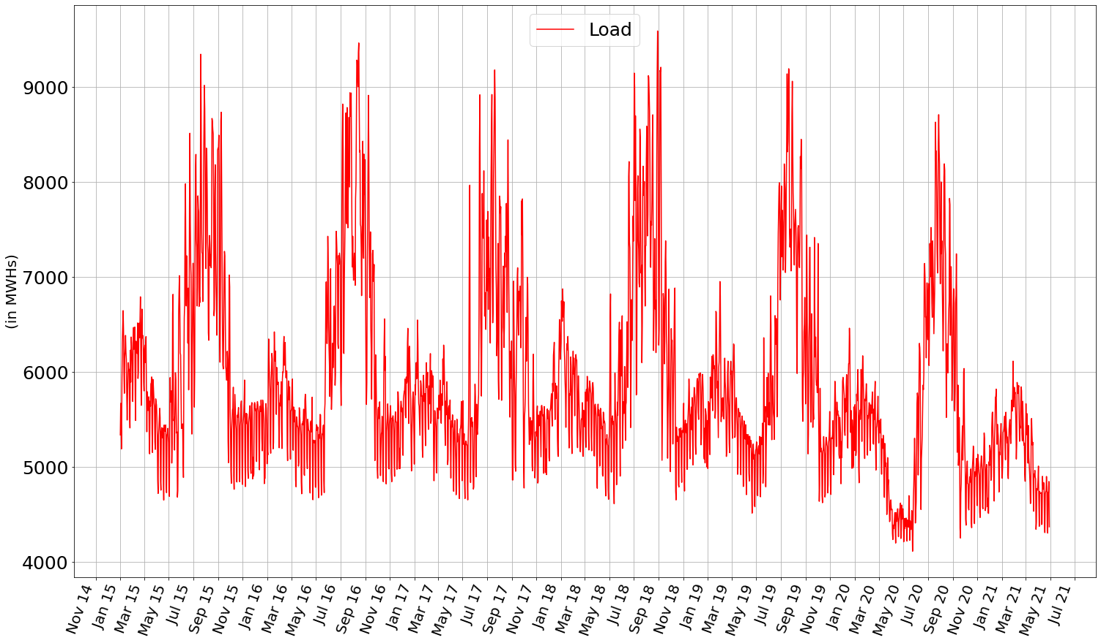
Historic Load Data
This red line depicts the load demand in the N.Y.C. region from 2015 to 2021.

Slide 4
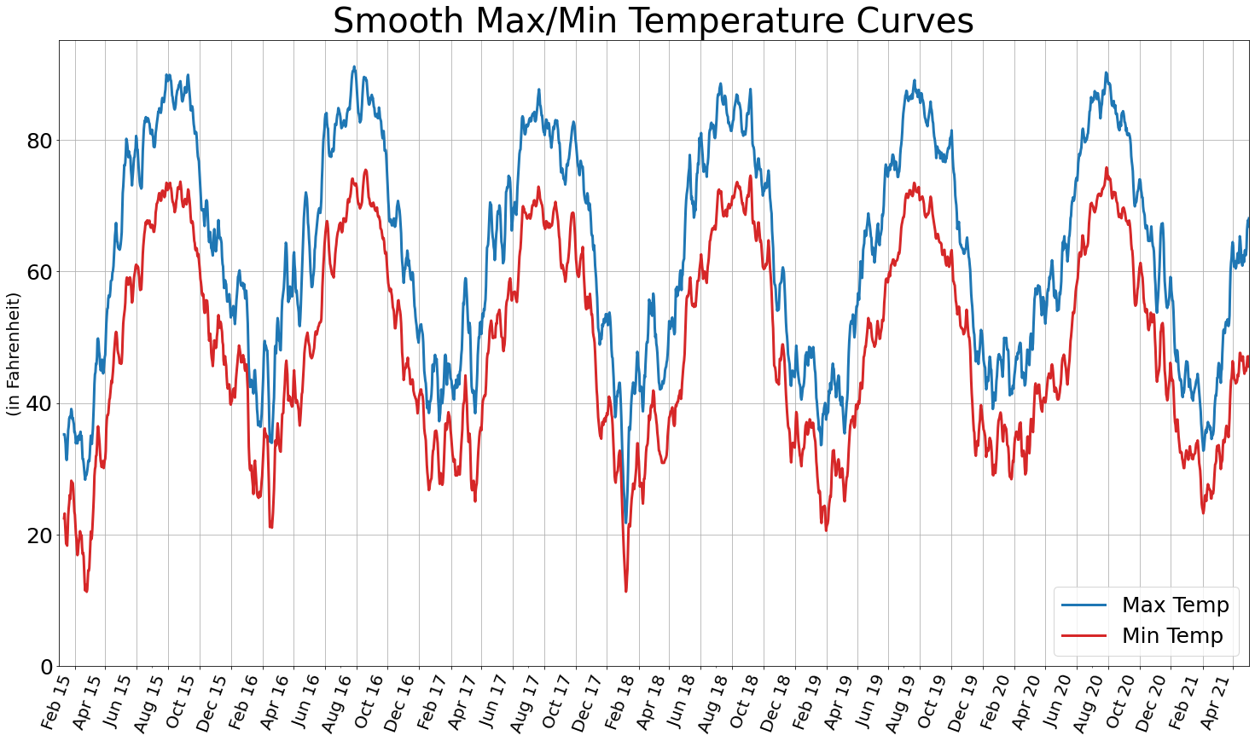
We observe a seasonality in the graph

Slide 5
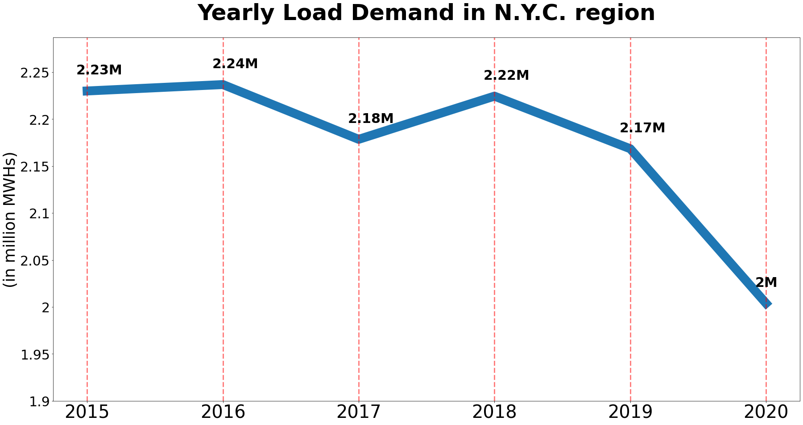
The graph on the previous page tells us about the energy demands in the N.Y.C. region from 2015 to 2021
We observe a seasonality in the graph with an increase in the usage of energy in the warmer months of June-July until November implying that the power plants and energy suppliers need to increase supply in the months from June
Keeping in mind a greater demand and lower supply can lead to a power outage
The period from November to May can be effectively utilized for maintenance of the power plants because of a decrease in demand
Compared to the peaks of energy usage in the years from 2015 to 2019, the year of 2020 saw a drop of nearly 0.17Million MWHs which is questionable with the rising population
Reliable Demographic data is needed for better forecasting of power demand but is not the only other variable

Slide 6
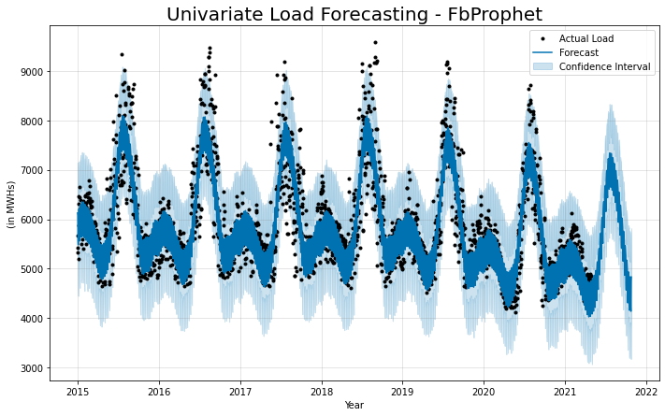

Slide 7
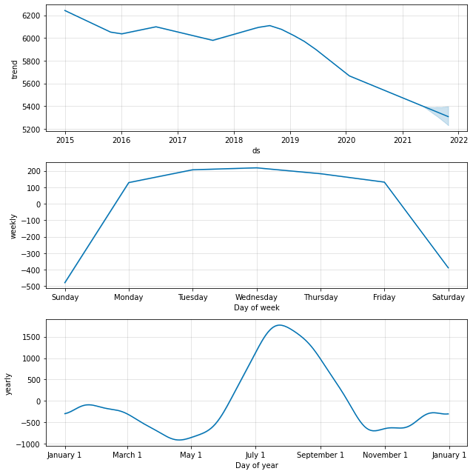
The graph on the previous slide shows us the forecast using FbProphet.
It is a univariate forecasting model, and it includes the yearly seasonality, weekly seasonality and the trend.
We observe a downward trend in electricity demand from the top graph here.
The forecast is within the Confidence Intervals.
Monday-Friday; people are working in offices hence, there is a higher demand of power with a drop in the weekends.
The warmer months tends to increase the demand due to the heat hence cooling systems use most of the power, plus people tend to be more out-going in summer hence commercial usage increases.
This model considers 95% confidence and gives a good prediction of the demand in the coming months keeping in mind the uncertainty.
The numerical values of the predictions are present in an excel file in the GitHub repository

Slide 8
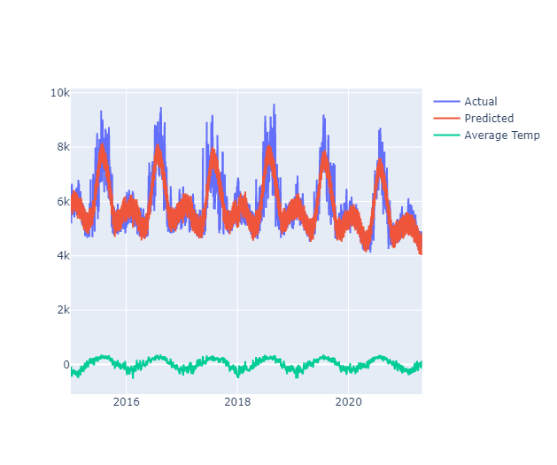
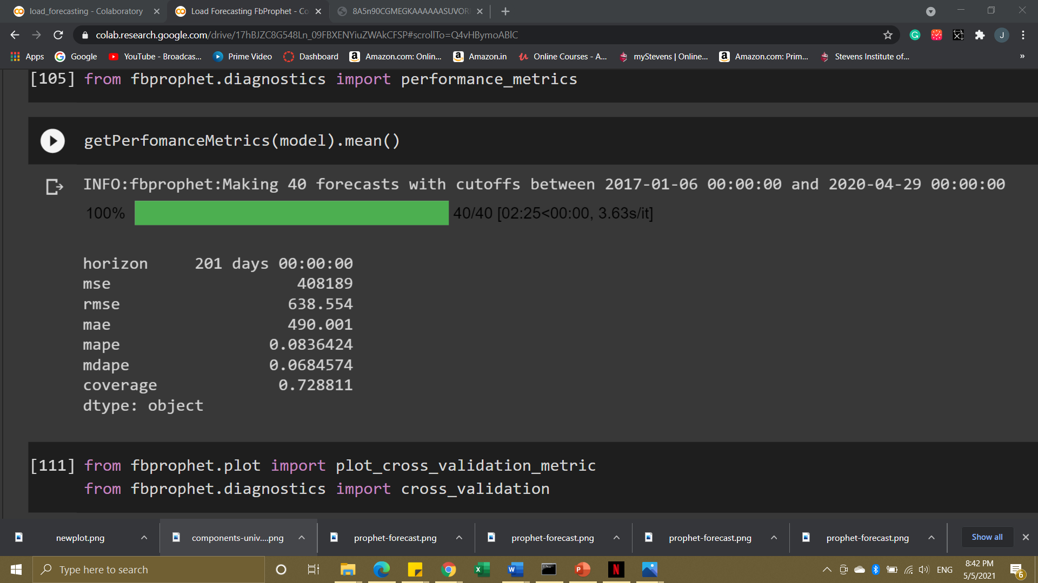
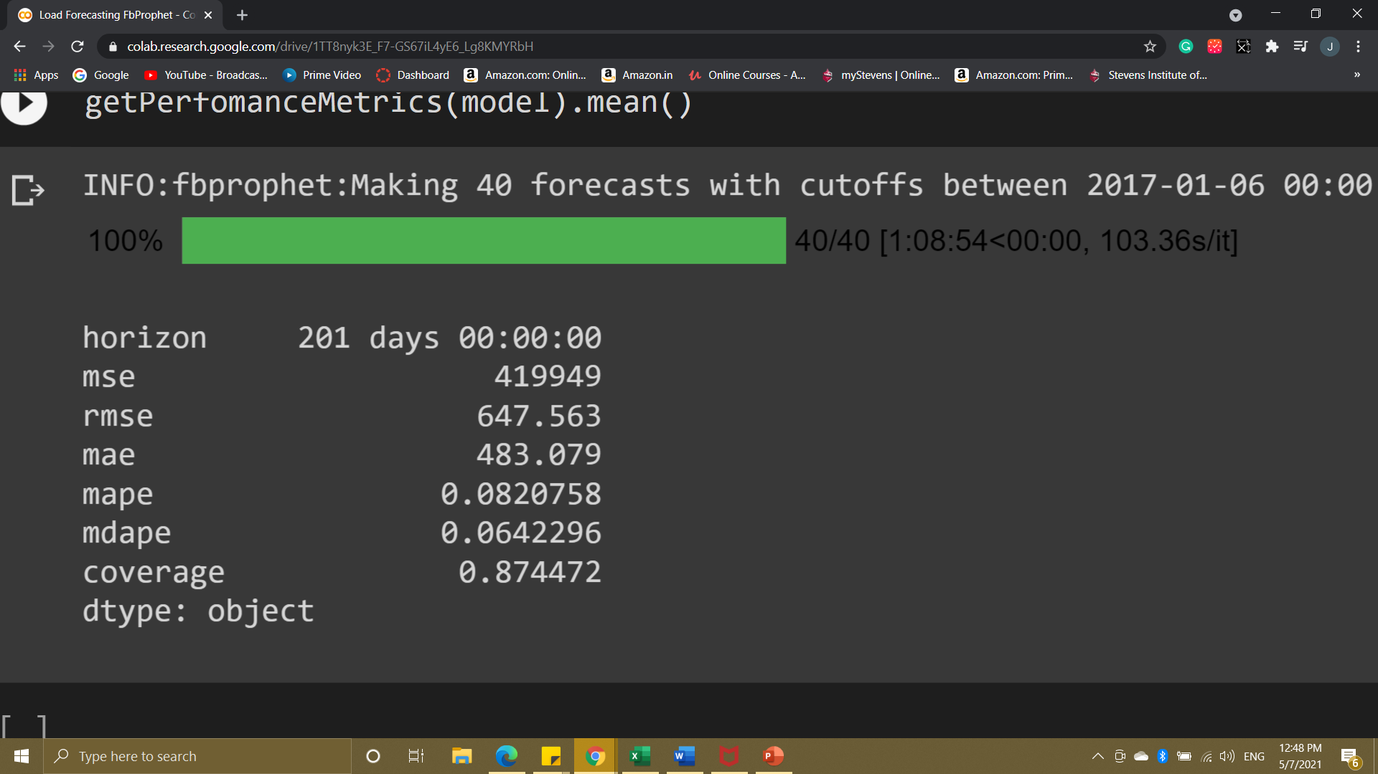
Performance
Metrics
This graph is also a FbProphet model where in there is an extra regressor ‘Avg_temp’
The performance metrics states that the mape(mean absolute percentage error) is <10% which implies that the model is excellent
And the added regressor decreased the percentage error, Hence the Univariate Model is better

Slide 9
Conclusion:
The Univariate Model is best suited for future predictions in this dataset
The Conventional AR, MA, ARMA models are having very high RMSE values, which indicate that for this data which has seasonality, and slight trend it is better to use a sandbox model like FbProphet to forecast optimum results
Concluding with COVID being a driving force in the decrease in the energy demand, the prices can marginally be increased to offsets losses but in long run people may use less energy and succumb to renewable energy source. Power Industry should take advantage of subsidy and lower cost of renewable equipment to set up small energy units nearby cities to decrease the power loss occurring during long-distance transmission

Slide 10
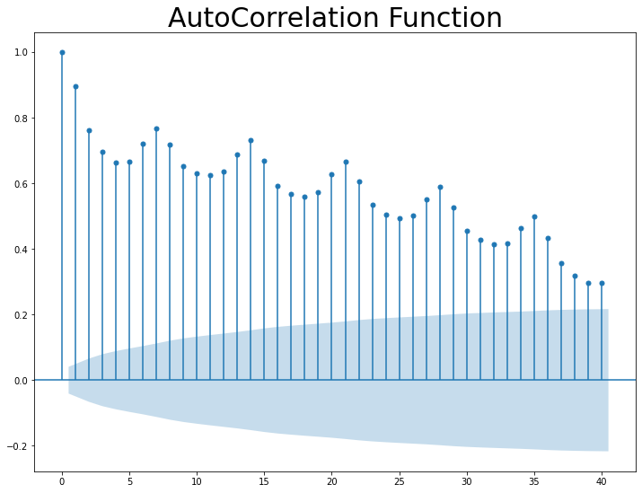
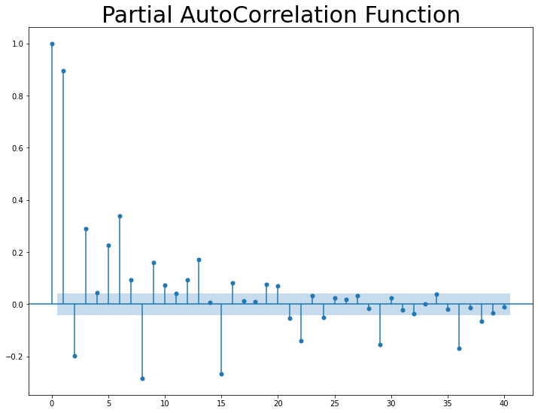
Notes:
The ACF and PACF plots suggests that it is better to use a non-conventional model because modeling such a data to forecast will incur much resources and the goal of this analysis is to ensure that the Trade-off between Time, Resources and Accuracy should be given to Accuracy of the Prediction. Hence, I suggest using FbProphet to forecast the Energy Demand in future.

